Slide 1

Loknete Hanmantarao Patil Charitable Trust’s Adarsh Institute of Technology & Research Centre, Vita Project Presentation on, Virtual Digital Metaverse Chartered Accountant Project Members : 1. Patil Akhilesh Ramdas (CS4031) 2. Ganesh H (CS4038) 3. Jadhav Gauri Ashok (CS4039) 4. Jadhav Shweta Shrirang (CS4040)
Guide Name : Asst. Prof. Mr. P. T. Shitole

Slide 2
Contents
Introduction
Objective of Project
System Architecture
Advantage
Disadvantage
Requirement analysis
Screenshots
Future Scope
Conclusion
Reference

Slide 3
Introduction
AI based CA manages budgets, auditing, taxes and business strategies for clients.
Virtual digital chartered accountant can handle all your financial need in the virtual world.
Users can receive real times update on their financial status.

Slide 4
Objective of Project
It manages finance in a more efficient & effective way.
There is no need of traditional accounting practices are no longer.
Main goal is to create system the latest technologies, and user-friendly financial management solution.
Ultimate aim to create the way for new era of virtual digital metaverse chartered accountants.

Slide 5
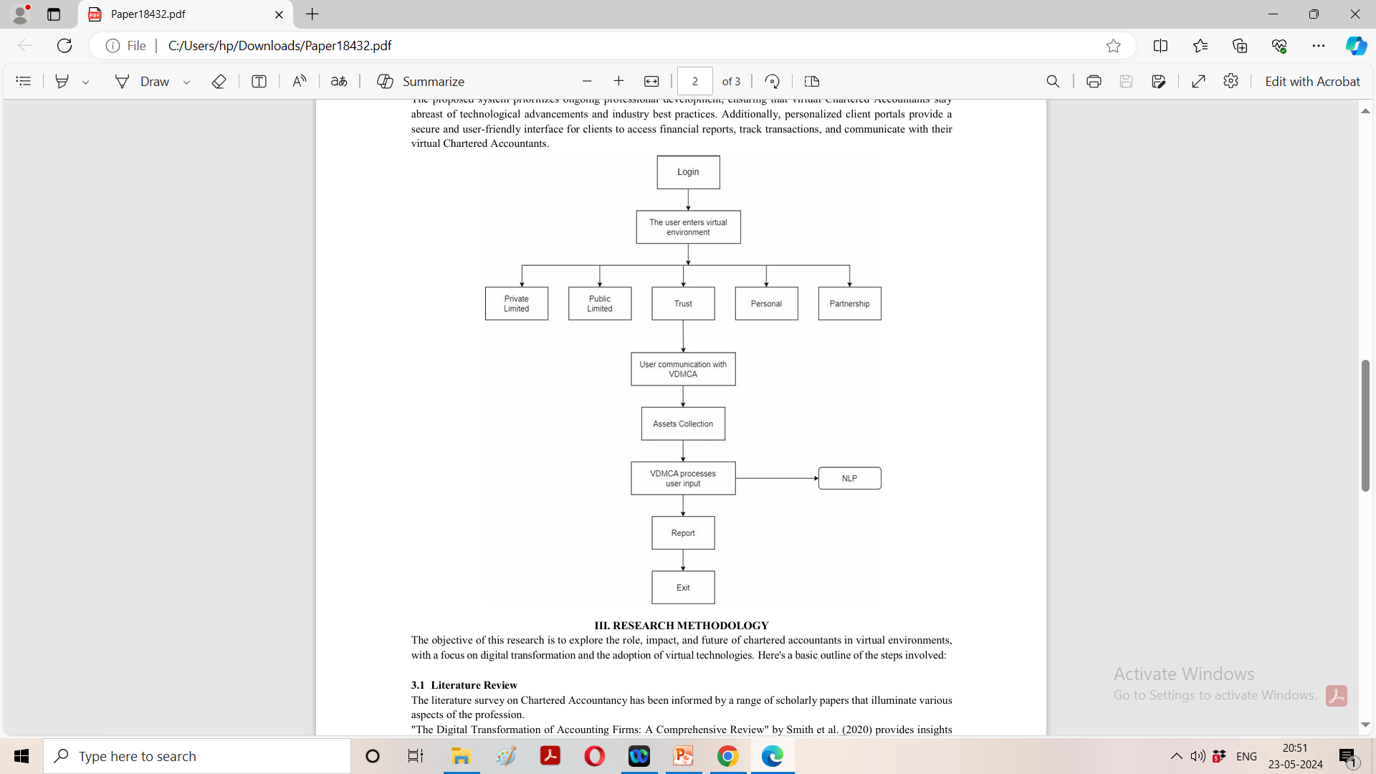
System Architecture

Slide 6
Advantages: -
1. Cost Efficiency.
2. Fast Result Calculation.
3. Scalability.

Slide 7
Disadvantages
1. Weak network may create problem.
2. Delay in communication.
3. Less Security.

Slide 8
Requirement Analysis
HARDWARE REQUIREMENT:
1. A standard computer
2. Internet connection for data access and deployment
SOFTWARE REQUIREMENT:
1. Python for programming
2. flask for web application
3. Database Management

Slide 9
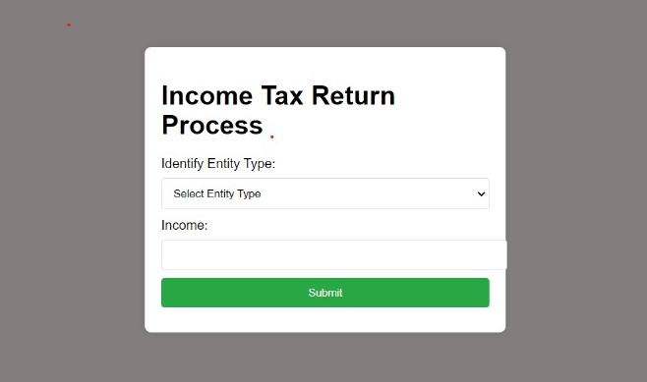
Screenshots

Slide 10
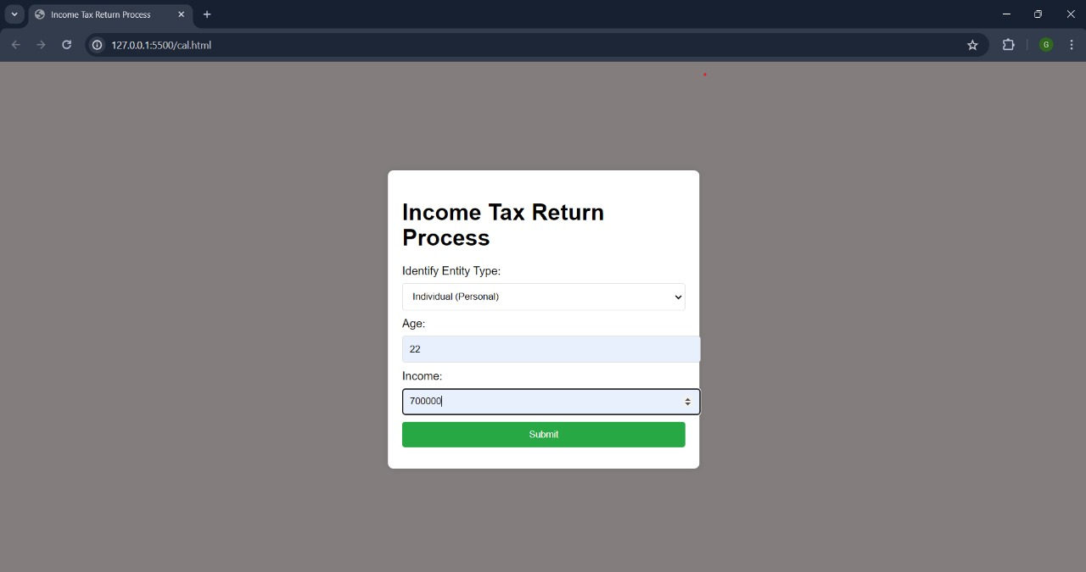

Slide 11
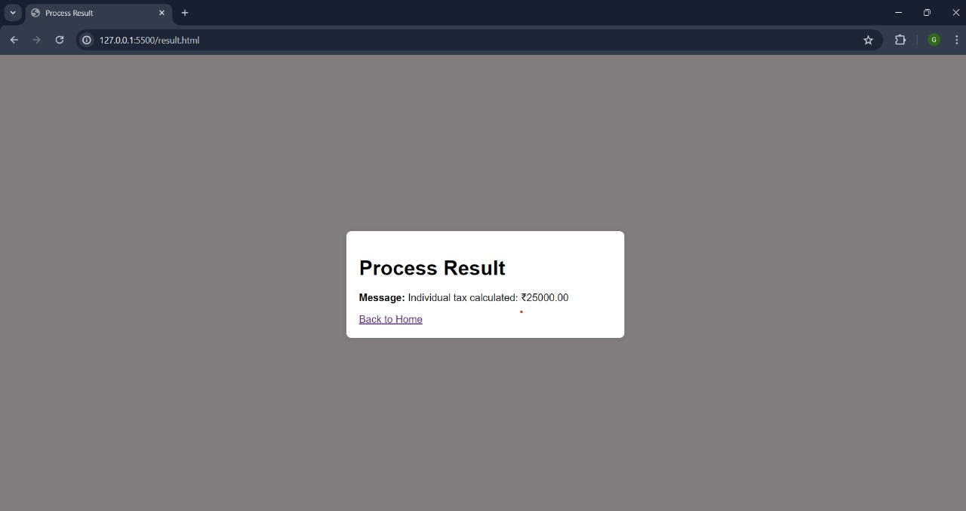

Slide 12
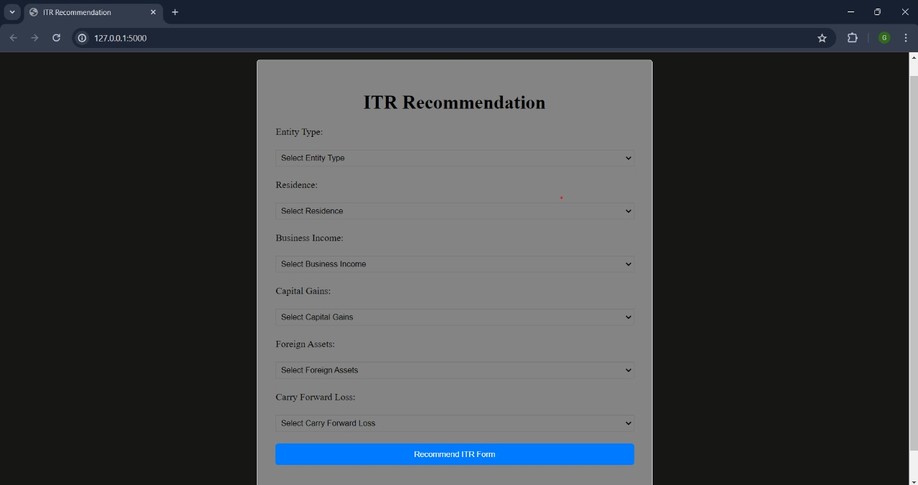

Slide 13
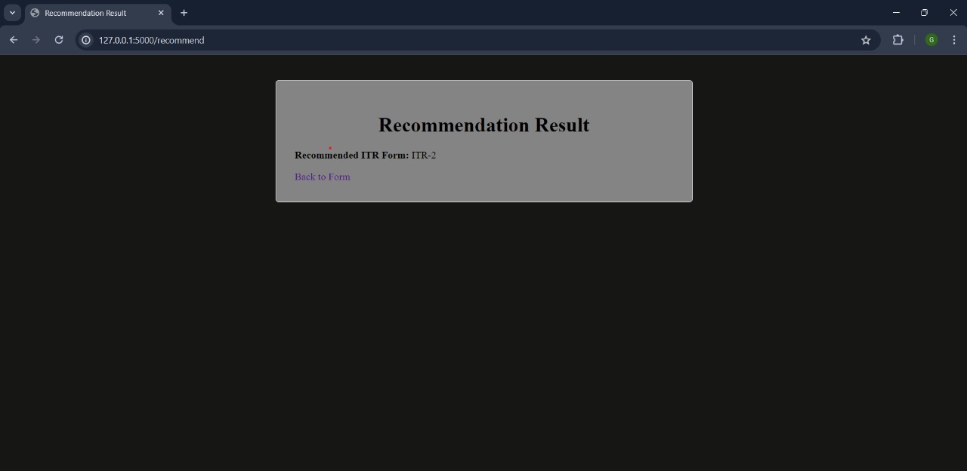

Slide 14
Future scope
Technology Advancements.
Automation and AI Integration.
Remote Collaboration Platforms.

Slide 15
Conclusion
As we more towards a more digital interconnected world.
We can elevate the accounting profession & better service to our clients.
Embrace potential of virtual digital metaverse chartered accountants & work towards a brighter future for accounting industry.

Slide 16
References
Lee, C., & Kim, D. (2021). AI and Machine Learning in Accounting and Finance: Integrating Traditional Processes into the Digital Era. Journal of Financial Technology, 5(2), 78-94.
Chen, L., & Wang, Q. (2020). Blockchain and Financial Accounting: Challenges and Opportunities. International Journal of Accounting Research, 8(3), 45-63.
Patel, R., & Sharma, P. (2021). Enhancing Financial Services with Metaverse Technologies: A Case Study. Proceedings of the Annual Conference on Emerging Technologies in Finance, 45-57.

Slide 17
Thank You

